Slide 1
SERTS AFP
Bobby Edwards
Dawson Dreiling
12/12/18

Slide 2
System Requirements
Select a specific song
Play the selected song
Pause the selected song
Resume the selected song
Go to the next song
Go to the previous song

Slide 3
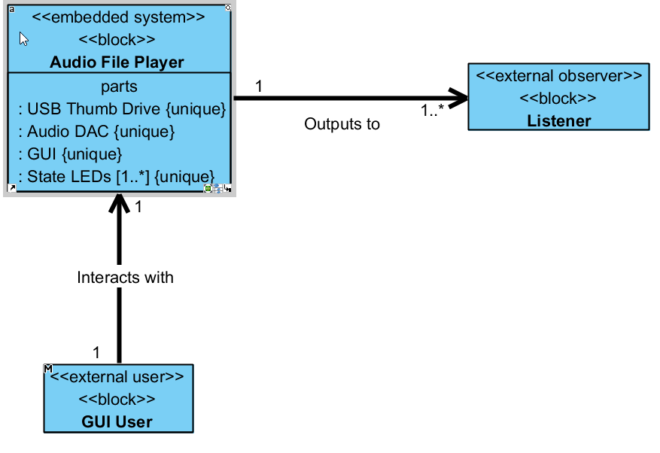
System Context Diagram

Slide 4
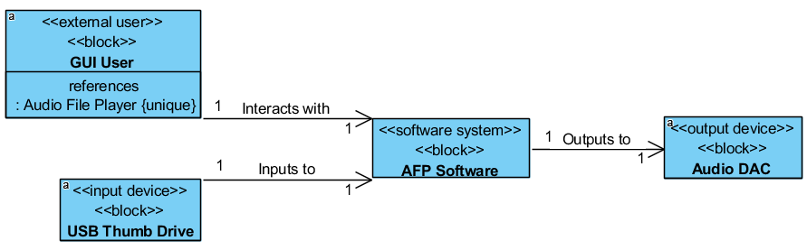
Software System Context Diagram

Slide 5
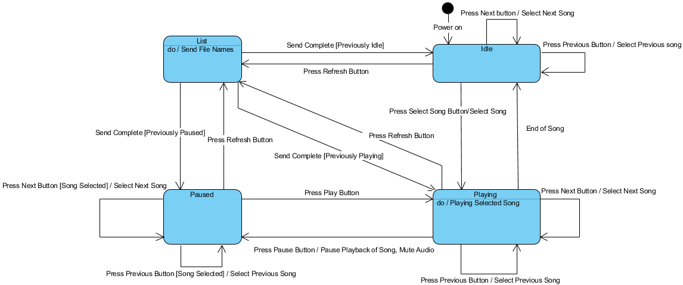
System State Machine

Slide 6
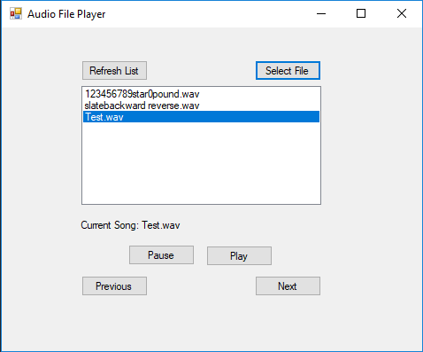
AFP GUI

Slide 7
Demo!

